Slide 1


Pothole repairs in winter conditions
Michael Reynolds, Viatec UK

Slide 2
Extract from C.J. Summers’
‘Idiots Guide to Highway Maintenance’
It is extremely important to take into account the WIND CHILL FACTOR when laying hot bituminous materials, especially when laid in thin layers.
This problem relates especially to H.R.A. WEARING COURSE when applying PRECOATS, and in particular with a "dry" H.R.A. DESIGN WEARING COURSE. The minimum air temperatures laid down in specifications allowing the laying of bituminous materials do not always take account of wind speed. The rate at which a "hot material" looses heat is greatly increased with increase in wind speed. Graphs are available in the "700" series in the March 1998 DOT Specification for Highway Works.
WIND CHILL is a very real problem, and if you do not take account of it in your site management the quality of work will suffer.
ALL MATERIAL TO BE LAID TO BE ON SITE BEFORE YOU START LAYING, HAVE THE CHIPPER CLOSE BEHIND THE PAVER, AND THE ROLLER CLOSE BEHIND THE CHIPPER
A hot material laid at an actual air temperature of plus 7 degrees centigrade and a wind speed of 25 m.p.h. will loose heat at a rate equal to a still air temperature of minus 5 degrees.

Slide 3

BSEN 594987 (2010)- Coated macadam (asphalt concrete) for roads
Do not lay in standing water, where possible remove water from patches and potholes prior to laying.
Do not lay on frozen ground.
Met Office data shows UK average number of
rainy days is 145 per year.

Slide 4
Can’t use hot-mix?
With the problems using hot-mixes in wet and cold weather, why not use cold-mix?

Slide 5
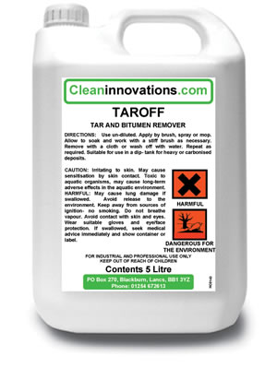
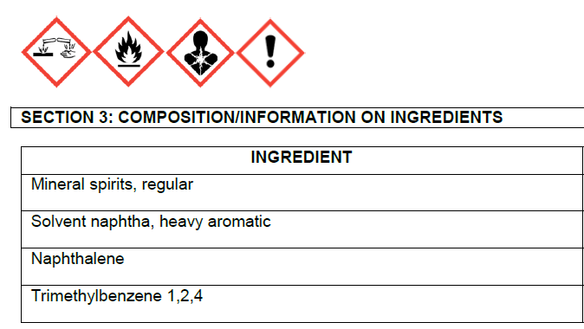
Bitumen Cleaner or cold-mix binder ingredient?
Danger
Causes skin burns and eye damage. Harmful if inhaled. May cause drowsiness or dizziness. May cause respiratory irritation. Suspected of causing cancer. May be fatal if swallowed and enters airways. Flammable liquid and vapour.

Slide 6
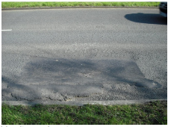
Cold PCSM repair failure – bleeding & rutting

Slide 7
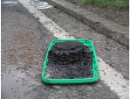
Incomplete curing and surface crusting of cold-mix

Slide 8

Solvent Content of Cold-Mix Binder
Material Testing Laboratory
Specimen age | Total mass lost (M %) PCSM Viafix Depot stock
1 day | 9.7 | 0.5 | 36.7
2 days | 11.3 | 0.5 | 40.2
3days | 11.3 | 0.5 | 40.4
PCSM tested is considered to be ‘solvent-free’ under EU Law.

Slide 9

Extract: Enterprise presentation to Staffs Highways
Appendix A10. PCSMs
Re - worded and moved to A2 – A10 not now used.
Materials are now to be approved as equivalent to a Hot Lay type and used as appropriate.
Due to concerns over soft and unstable PCSMs they must be capable of wet flush core sampling, to allow void testing, at 6 months from the date of permanent reinstatement (A8.3)
On occasion materials were so soft that cores could not be obtained even after 2yrs in the ground so how could these materials be ‘equivalent to hot-lay’?

Slide 10
Marshall Load Comparison
Material Testing Laboratory
Test temp | Marshall Load Value (kN) PCSM Viafix depot stock
25ºC | 0.7 | 16.5 | n/a disintegrated
60ºC | n/a disintegrated | 5.8 | n/a disintegrated
The test at 60ºc was carried out to enable a comparison to hot-mix asphalt

Slide 11
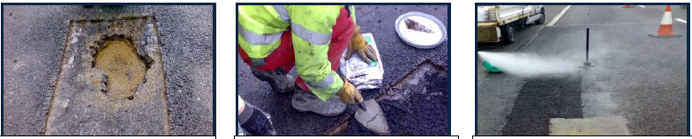
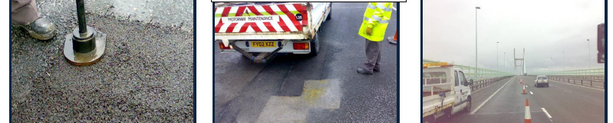
Viafix repairs on wet trunk roads:
Severn Bridge M4

Slide 12
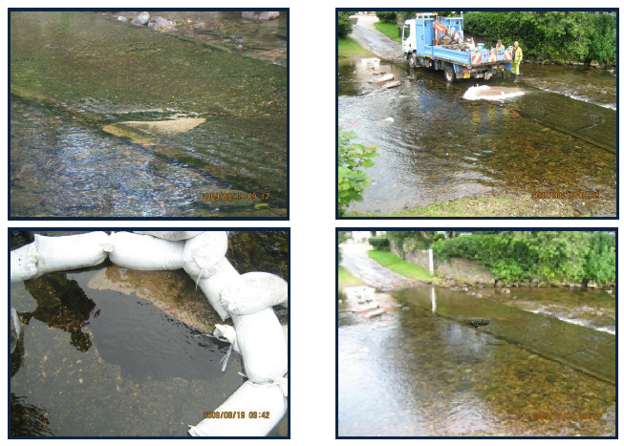
Viafix in ‘quite wet’ situations!

Slide 13
Quote from Viafix user
“I have never seen a more effective cold material. It really does do what it says it will. The first time we used it was three years ago during a cold, wet winter’s night for a ‘water-burst’ on a busy arterial road and the Viafix repair is still there, completely intact!’’
Brian Allinson, Depot Supervisor, Renfrewshire Council in Western Scotland.

Slide 14

Client testimonials
“The silver bullet of cold lays” - Lancashire Highways;
“It does exactly what it claims” - Cumbria Highways;
“The best thing since sliced bread, very impressive” - Transerv Scotland
‘’We call it magicadam ‘’ - London Borough of Islington
“The dog’s!’’ - Surrey CC Materials lab.
‘’All your claims are true , it’s brilliant’’ - Highways Agency Area 10.
‘’Superb in the wet unlike the other stuff!’’ - Cambridgeshire Highways.
“Extremely versatile especially useful for busy roads’’ - East Lothian Council.
‘’Never had a defect with Viafix repairs, even in the London Borough of Bromley!’’ - BT Openreach

Slide 15

HAPAS approval

Slide 16
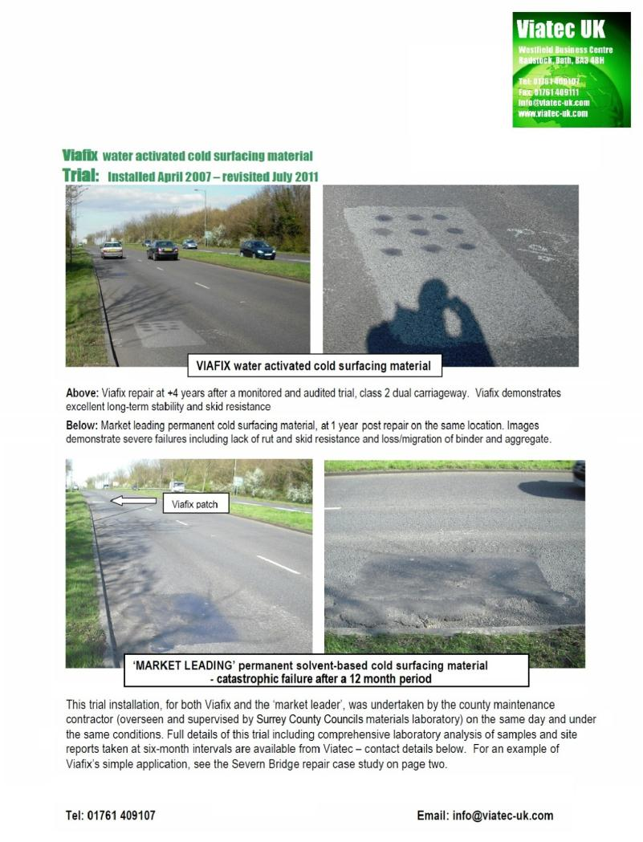
Viafix test patch wheel-track area lane 1, A320
Laid April 2007
Patch in good condition Dec 2014

Slide 17
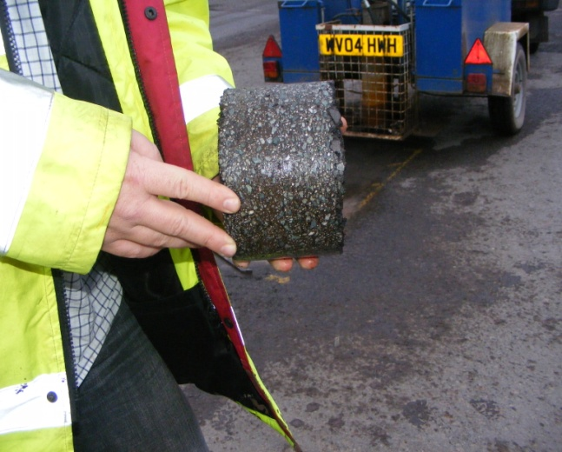
viafix cored 24 hours after compaction
Void content approximately 8%

Slide 18
Viafix wheel tracker test result

Slide 19
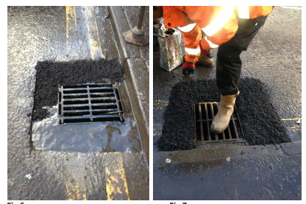
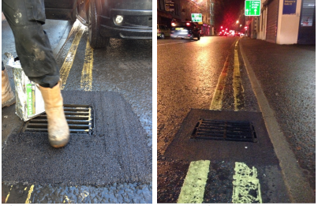
Gulley reinstatement, standing water
Demonstration for Northern Ireland Road Service, Ballymena, Jan 2013
1 2 3 4
Water displaced by loose Viafix (in freezing conditions, Jan2013)
Viafix dropped in by hand
Compaction by traffic
Finished repair

Slide 20
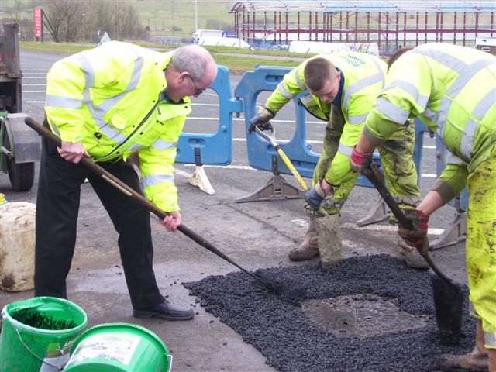
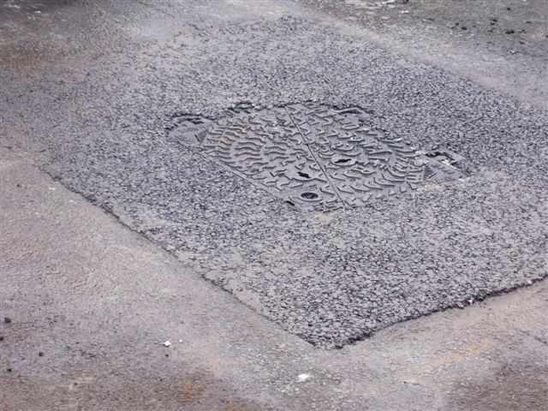
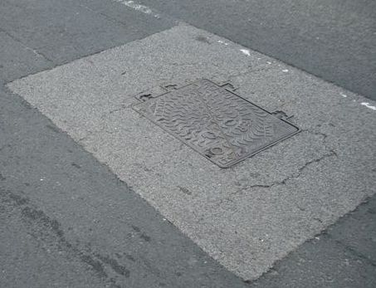
Reinstatement on a dual carriageway: Roman Road A6078, Blackburn
Viafix repair being made
Compacted finish – May 2008
Still intact March 2012

Slide 21
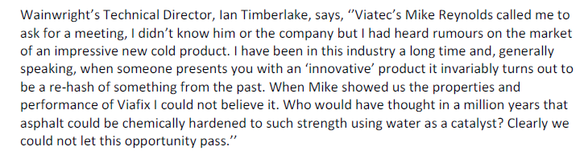

New venture for UK production of Viafix

Slide 22
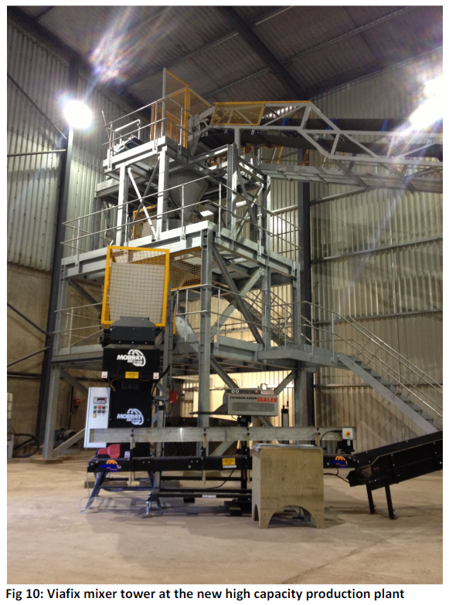
Viafix mixer tower at Viatec’s new high capacity production plant

Slide 23
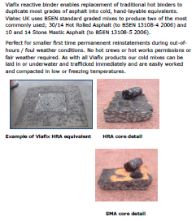
Viafix HRA and SMA equivalents

Slide 24
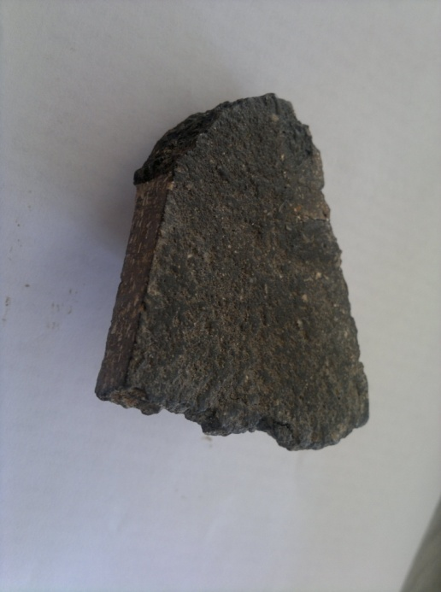
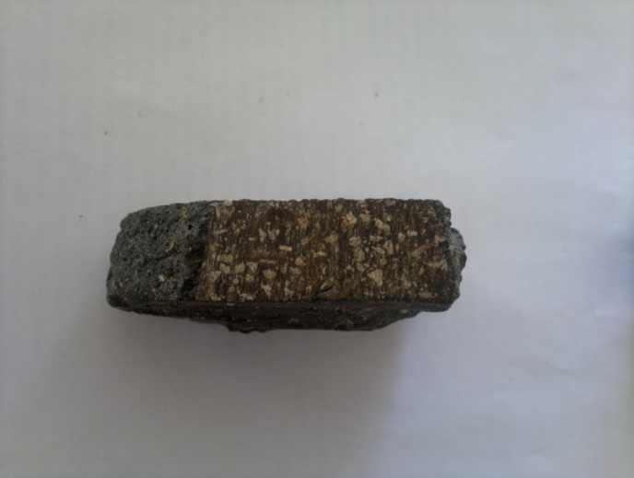
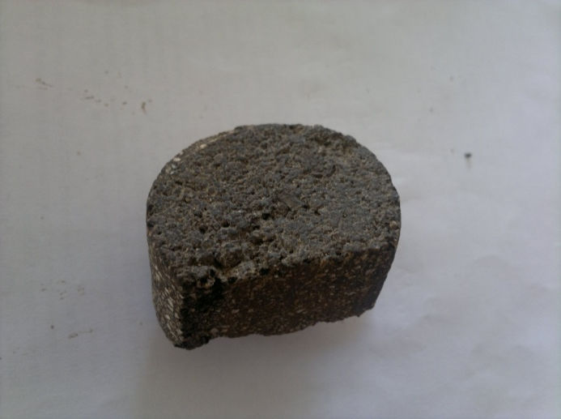
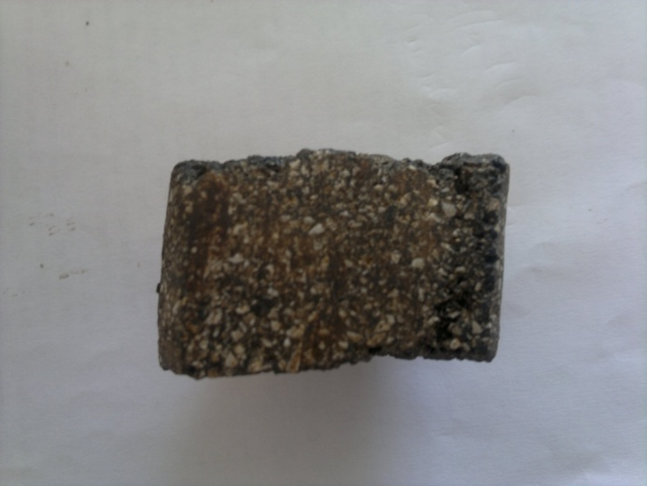
Viafix Mastic Asphalt Alternative for Thames Water
Hot Mastic sample as supplied by Essential Water Services
Viatec Cold Mastic Alternative

Slide 25
*Run through ‘neighbouring’ folder with datasheet examples.
Thank-you for your time. Any questions?

